Slide 1
Weekly Update
Visualization Team
Brian Zhang, Saurav Chatterjee, Zachary Stephens
Faculty Advisor: John Leonard
Sponsor: Michael Karafotis
10/07/2019

Slide 2
Goals for this Week
Expand and solidify node map to incorporate two businesses with different structures (ie, one-to-one infrastructure/app relationships, versus shared platforms)
Try to create a visualization (example) and incorporate randomly generated data.
Try to format the table section in neo4j, if possible.
Meet with the BoA team on site.

Slide 3
Accomplishments/Challenges Encountered
Accomplishments:
We presented our models to the sponsor and received feedback.
The model we presented was further developed than the sponsor expected, and seems to be moving in the right direction.
Challenges:
The feedback we received had little critique.
The sponsor is undecided on whether the model should function in real-time or periodically for report generation.
The Bank is planning on moving to the Cloud in the foreseeable future, which may complicate or invalidate our model if we lack flexibility.

Slide 4
Goals for Next Week
Explore the use of tags in Neo4J as a means of reducing the view to only the aspects you want.
Create random data with RapidMiner and pass it through to Neo4J.
This may require an intermediate script to handle formatting for Cypher.
Integrate language including Events, Incidents, Problems, and Changes into our current working model as a potential KPI.
If possible, expand our current example with more services/applications and connections.

Slide 5
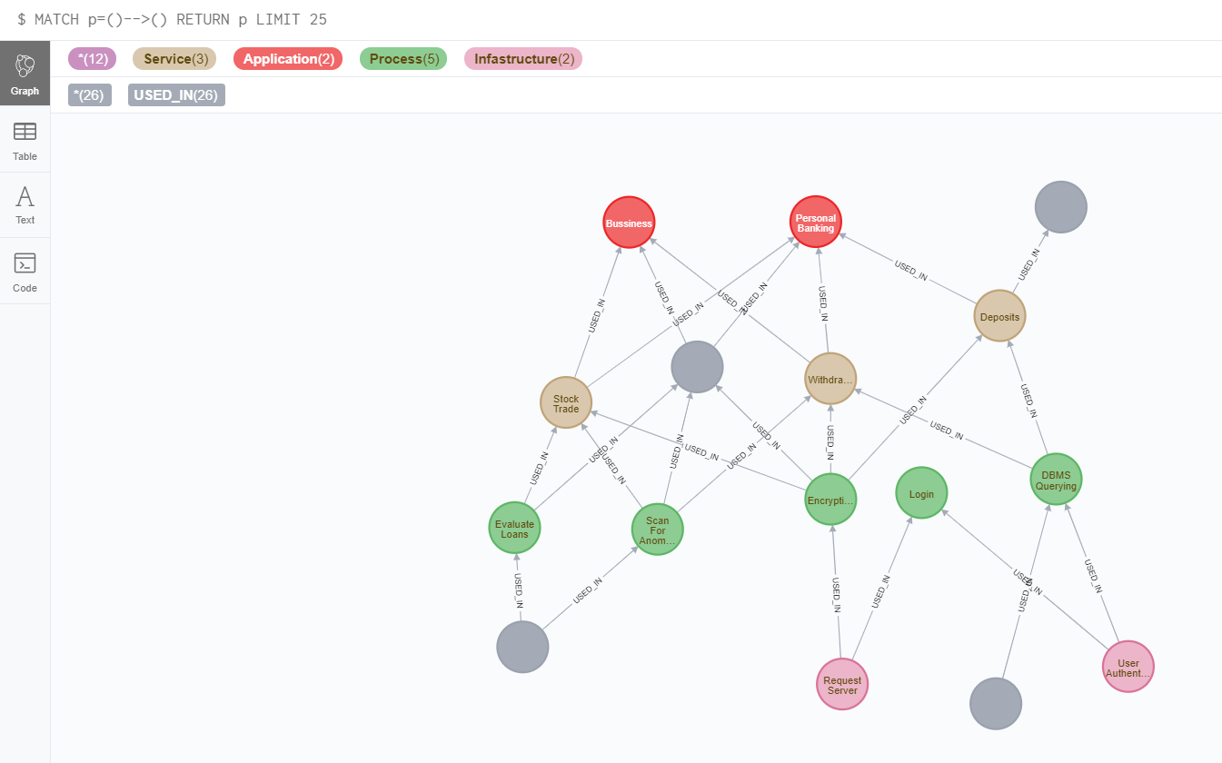
Neo4J

